Slide 1

Flight Delay Analysis
Presented By: Team2
Anjaneya Kamepalli(akamepalli2@horizon.csueastbay.edu)
Fabjola Kasaj (fkasaj@horizon.csueastbay.edu)
Deepthi Mounika Mandalaparty (dmandalaparty@horizon.csueastbay.edu)
Under the Guidance of:
Dr. Chongqi Wu
^{6th} May,2022

Slide 2
Agenda:
Team:2
Introduction
Project Scope
Project Phases
Data collection
Data cleaning
Map Reduce Process
Tableau Analysis Dashboards
Website hosting
Technical challenges faced
Conclusion

Slide 3
Introduction:
Team:2
AIM: Flight delay analysis to help the future travelers in making wise decision by choosing right carrier and airports.
Background/Purpose: Time is invaluable in global playing field. Travel delay is becoming metric in defining service quality. In Air travelling customers don’t have the platform/information to decide upon which carrier is best for them based on their diversified priorities. Our project is building a web interface for customers based on the true history of different carrier performance in past 10years. This website providing the graphical interface for different carriers and airports, by that users can avoid the predictable delays in their travel.

Slide 4
Project Scope:
Team:2
The scope of our project analysis is confined to the research questions described at the project planning phase.
Gathering the flight delay data from trusted source and preprocessing it.
Running map reduce Jobs to process the data and create the dataset for analytics
Building the Tableau dashboards for graphical representation of analysis
Building a website to provide user interface to interact with the dashboards
Departure Delay Vs Origin Airport; Arrival Delay Vs Origin Airport; Temporal Variability of Delays
Monthly Delay Trends & Reasons ; Carrier Arrival and Departure Delays
Carrier Vs National air system(Nas) Delay
Analyzing the Ripple effect, to determine the Probabilistic prediction of delays for each carrier.
Analyzing the average delay by origin city there by calculating the probability of carrier gets delayed or Probability of carrier to be on-time.
Analyzing the delay based on the Wheels_on_Time in correlation with distance groups and Airtime.

Slide 5
Project Phases:
Team:2
Data Cleaning
Map Reduce
Data Visualization
Building Web Interface
Data Reframing

Slide 6
Data Collection:
Team:2
Data is the backbone of Analytics; we should choose the trusted sources to collect data before to start working on project.
To collect the Flight Delay data, we have relied on the government website https://www.transtats.bts.gov/OT_Delay/OT_DelayCause1.asp?20=E
This data consists of domestic US flights reported to the United States Bureau of Transportation Statistics
We have downloaded last 10 years of data starting from 2010 to 2020
This is a huge dataset with 11,221,080 rows and 52 columns.
Filling factor almost 100%.

Slide 7





Dataset Overview:
Team:2
OP_UNIQUE_CARRIER: Unique Carrier Code.
ORIGIN_AIRPORT_ID: Origin Airport, Airport ID.
ORIGIN_STATE_NM: Origin Airport, State Name.
ARR_DELAY: Difference in minutes between scheduled and actual arrival time.
DEP_DELAY: Difference in minutes between scheduled and actual departure time.
BTS
The Bureau of Transportation Statistics

Slide 8
Data Cleaning:
Team:2
Dataset cleaning carried out by using python code
Dropping the rows with missing values
Dropping the unwanted columns from dataset
Running the Hadoop Map reduce jobs to preprocess the data
Creating the final version of cleaned dataset for all the years

Slide 9
Map Reduce Process:
Converting Source files for Analytics feasibility
running the Map reduce jobs by using Single node Hadoop cluster
public class AirlineCarrierNames {
public static class AirlineCarrierNamesMapper extends Mapper<Object,
org.apache.hadoop.io.Text, org.apache.hadoop.io.Text, DoubleWritable>{
@Override
protected void map(Object key, org.apache.hadoop.io.Text value, Mapper<Object,
org.apache.hadoop.io.Text, org.apache.hadoop.io.Text, DoubleWritable>.Context context)
throws IOException, InterruptedException {
if (!value.toString().contains("ARR_DELAY_NEW")) {
String[] input = value.toString().split(",");
if(input.length >7 && !input[7].equalsIgnoreCase("0") &&
!input[15].equalsIgnoreCase("0")){
org.apache.hadoop.io.Text flightCarrier = new
org.apache.hadoop.io.Text();
try{
flightCarrier.set(input[3].trim());
context.write(flightCarrier, new DoubleWritable(Double.parseDouble(input[30]))); }
catch (Exception ex) {
//throw ex;
//UniqueCarrier.set(input[2]);
//context.write(UniqueCarrier, new AverageBean(0, 0));
} }. }. } }

Slide 10
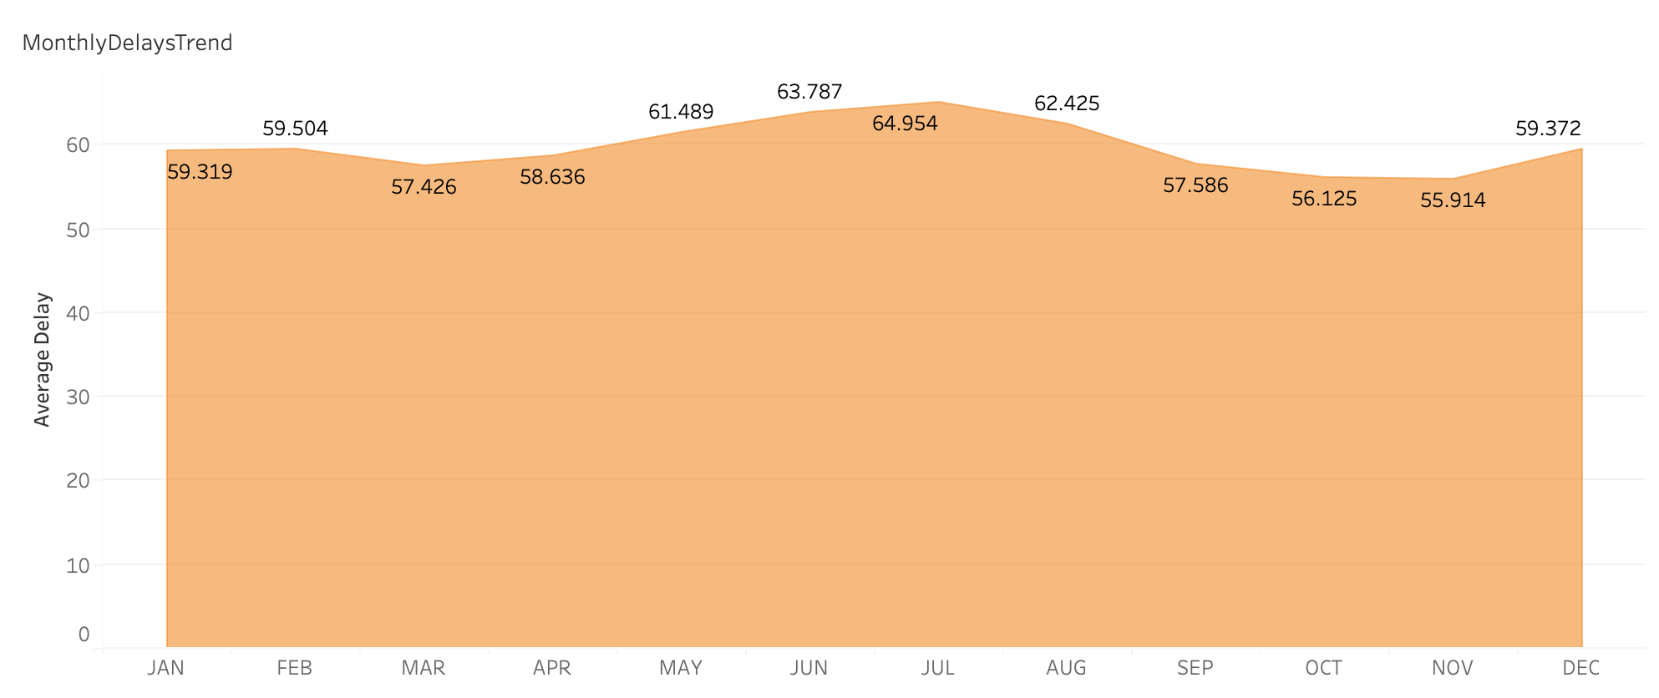
Monthly Delay Trends:
Team:2
July
The monthly average arrival delay for July is highest with 64.9 minutes and the monthly average arrival delay for November is the least with an average of 55.9 minutes ,compared to all the 12 months.
November
Hence November is the best time to travel and we can expect delays for sure in the month of July.
November, October, September and March
are the top preferred months to travel with least average delays.

Slide 11
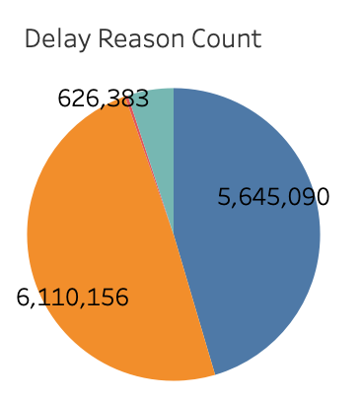
Flight Delay Reasons:
Team:2
NAS-Delay contributes more when compared to all the other reasons of delays in the below pie-chart with almost 50% occupancy.
Hence it is the most frequent reason for flight delays.
Carrier-Delays are the second most frequent reasons for delays.
Security-Delays contributes almost negligible count when compared to all the four reasons of delays.

Slide 12
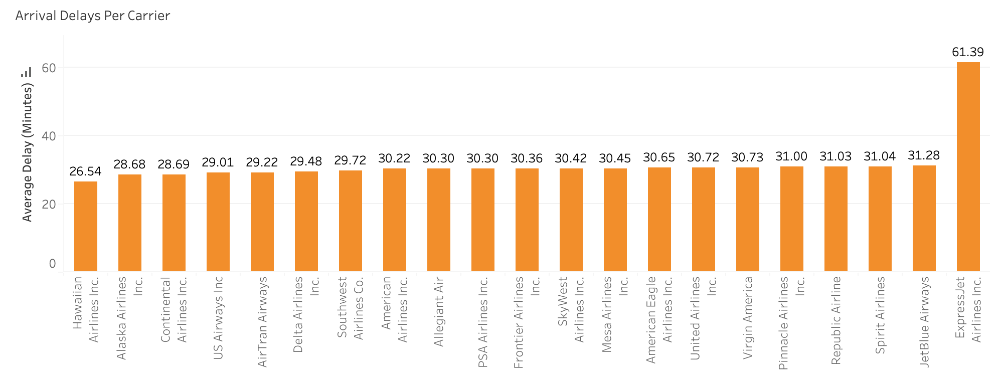
Average Arrival Delays Per Carrier:
Team:2
Hawaiian Airlines has the least average arrival delay of 26.5 minutes for the past 10 years of data when compared to all other airlines.
ExpressJet Airlines has the highest average arrival delay of 61.3 minutes when compared to all other airlines.
Almost all the other airlines excluding the above mentioned airlines have an average arrival delay of approximately 30 minutes.

Slide 13
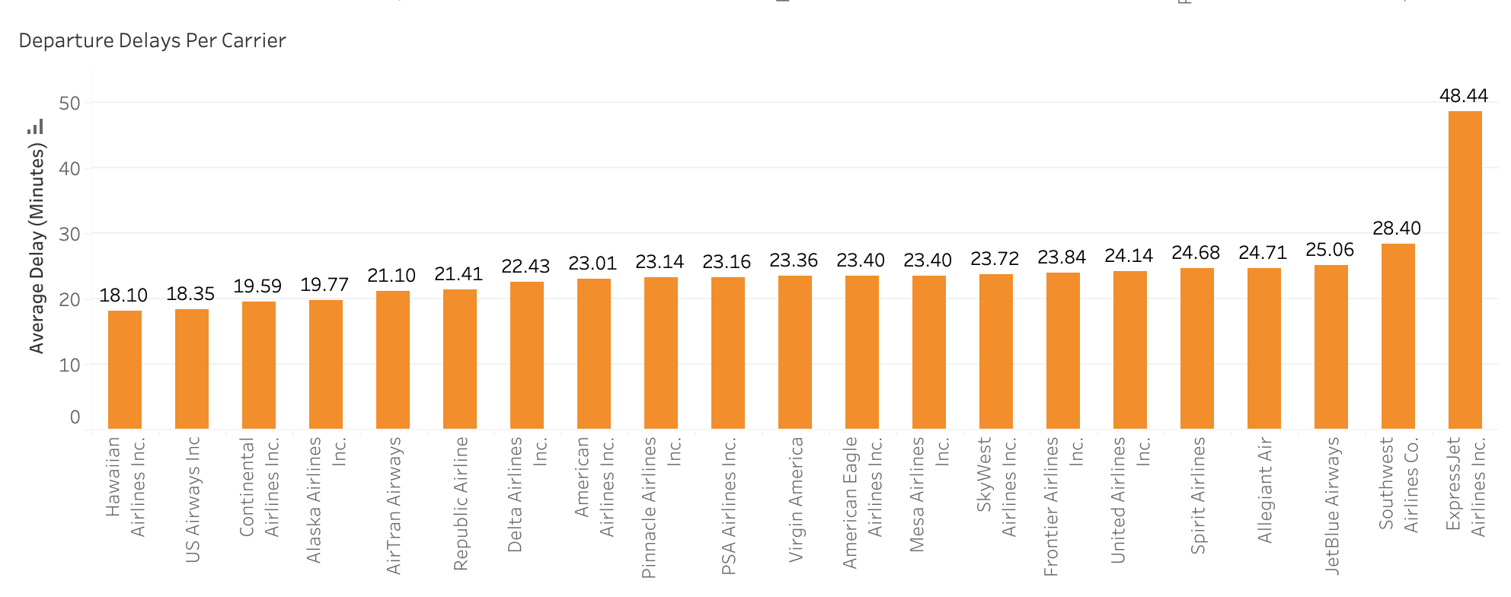
Average Departure Delay per Carrier:
Team:2
Hawaiian Airlines has the least average departure delay of 18.10 minutes.
ExpressJet Airlines has the highest average departure delay of 48.4 minutes for the past 10 years of data.
Almost all the other airlines have an average delay of approximately 20 minutes.

Slide 14
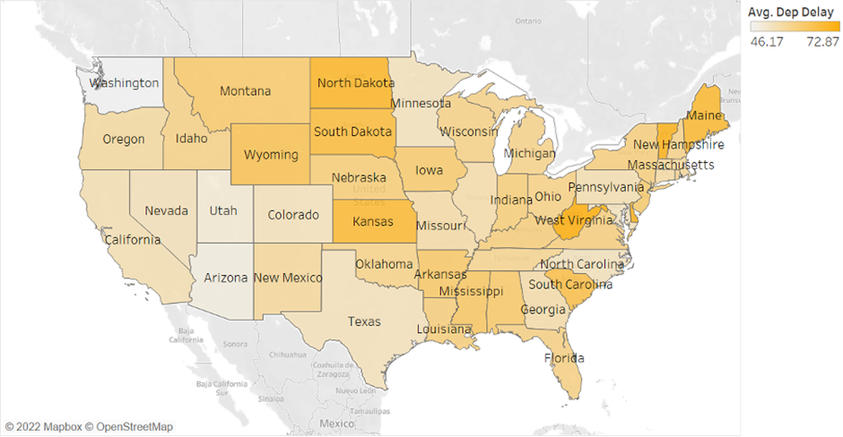
Mean Departure delay by airport:
Team:2
The departure delays vary from 46.17 to 72.87 minutes in average. The states with higher arrival delays are North Dakota, South Dakota and Kansas. While states with lower arrival delays are Arizona and Utah.

Slide 15
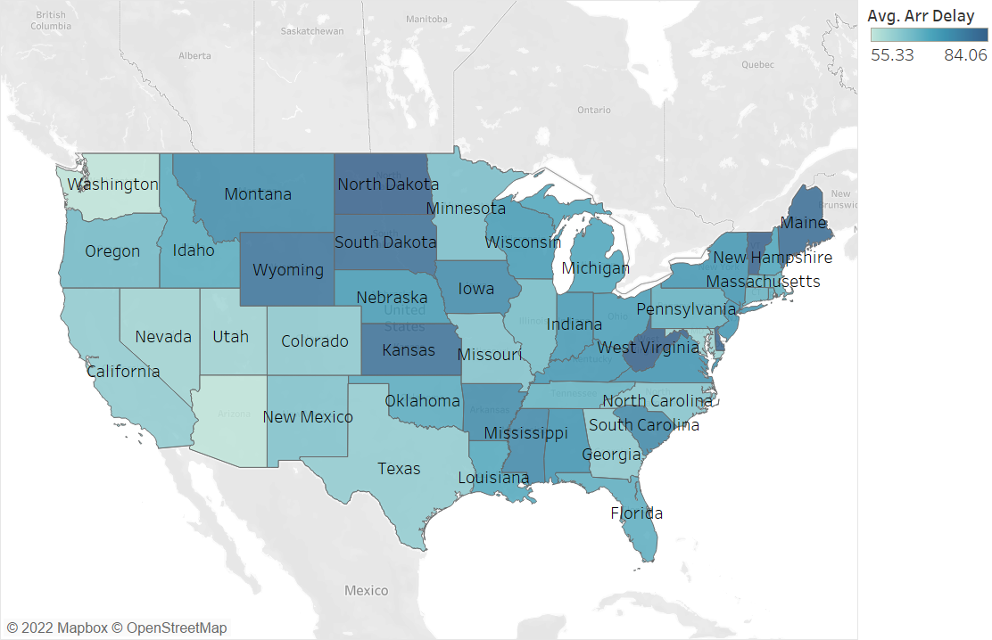
Mean Arrival delay by airport:
Team:2
The interval of arrival delays is 51.19 to 82.89 minutes in average. So, arrival delays seem to be longer departure ones. And the states with higher arrival delays are West Virginia, Kansas and North Dakota.

Slide 16
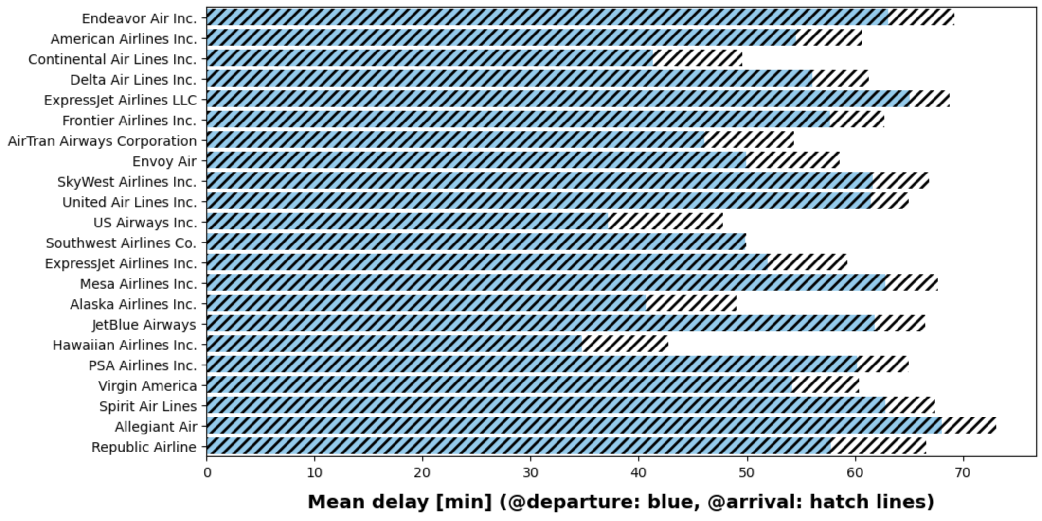
Take-off Vs Landing Delays:
Team:2
Delays at arrival are generally lower than at departure. This indicates that airlines adjust their flight speed in order to reduce the delays at arrival.

Slide 17
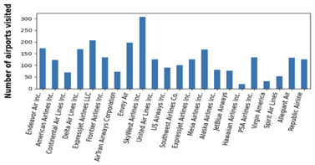
Count of Airports Visited by Carrier:
Team:2
In total we have 389 different airports in our dataset. Based on that, the graph shows the distribution of flights every airline company took in those airports.
From this graph we can notice that SkyWest Airlines, ExpressJet Airlines and Endeavor Air are the three companies with the largest flight numbers within the last 10 years.

Slide 18
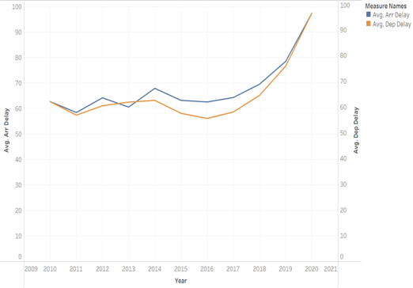
Line graph Arrival Vs Departure Delay:
Team:2
Observing the results overall there is a general tendency of having higher average arrival delays than departure delays in most of the cases.

Slide 19
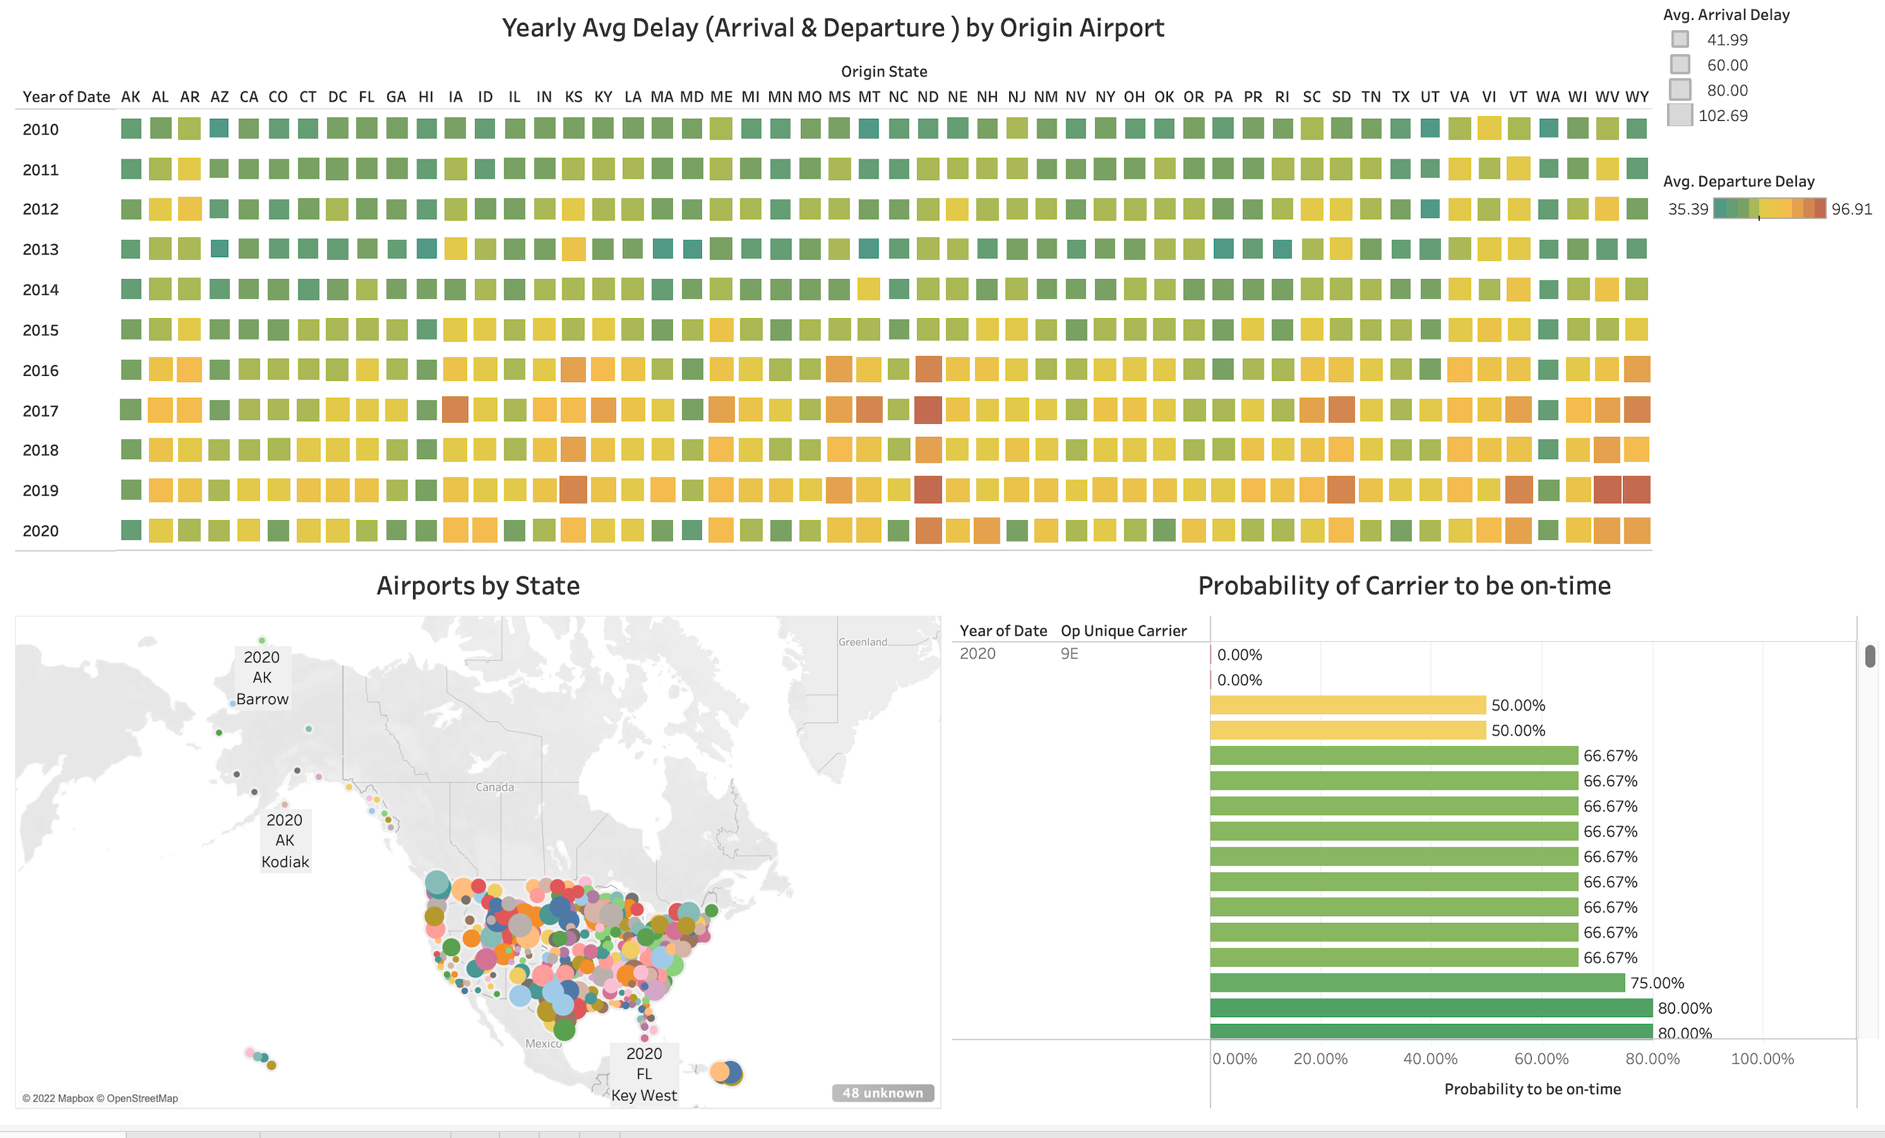
Tableau Data Visualization:
Team:2

Slide 20
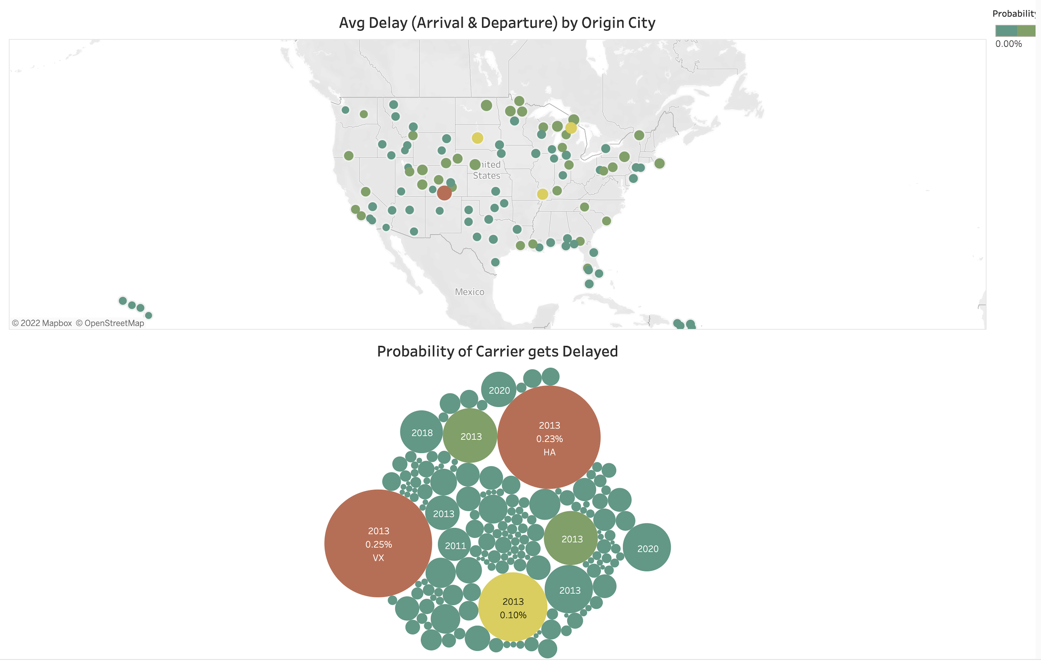
Tableau Data Visualization:
Team:2

Slide 21
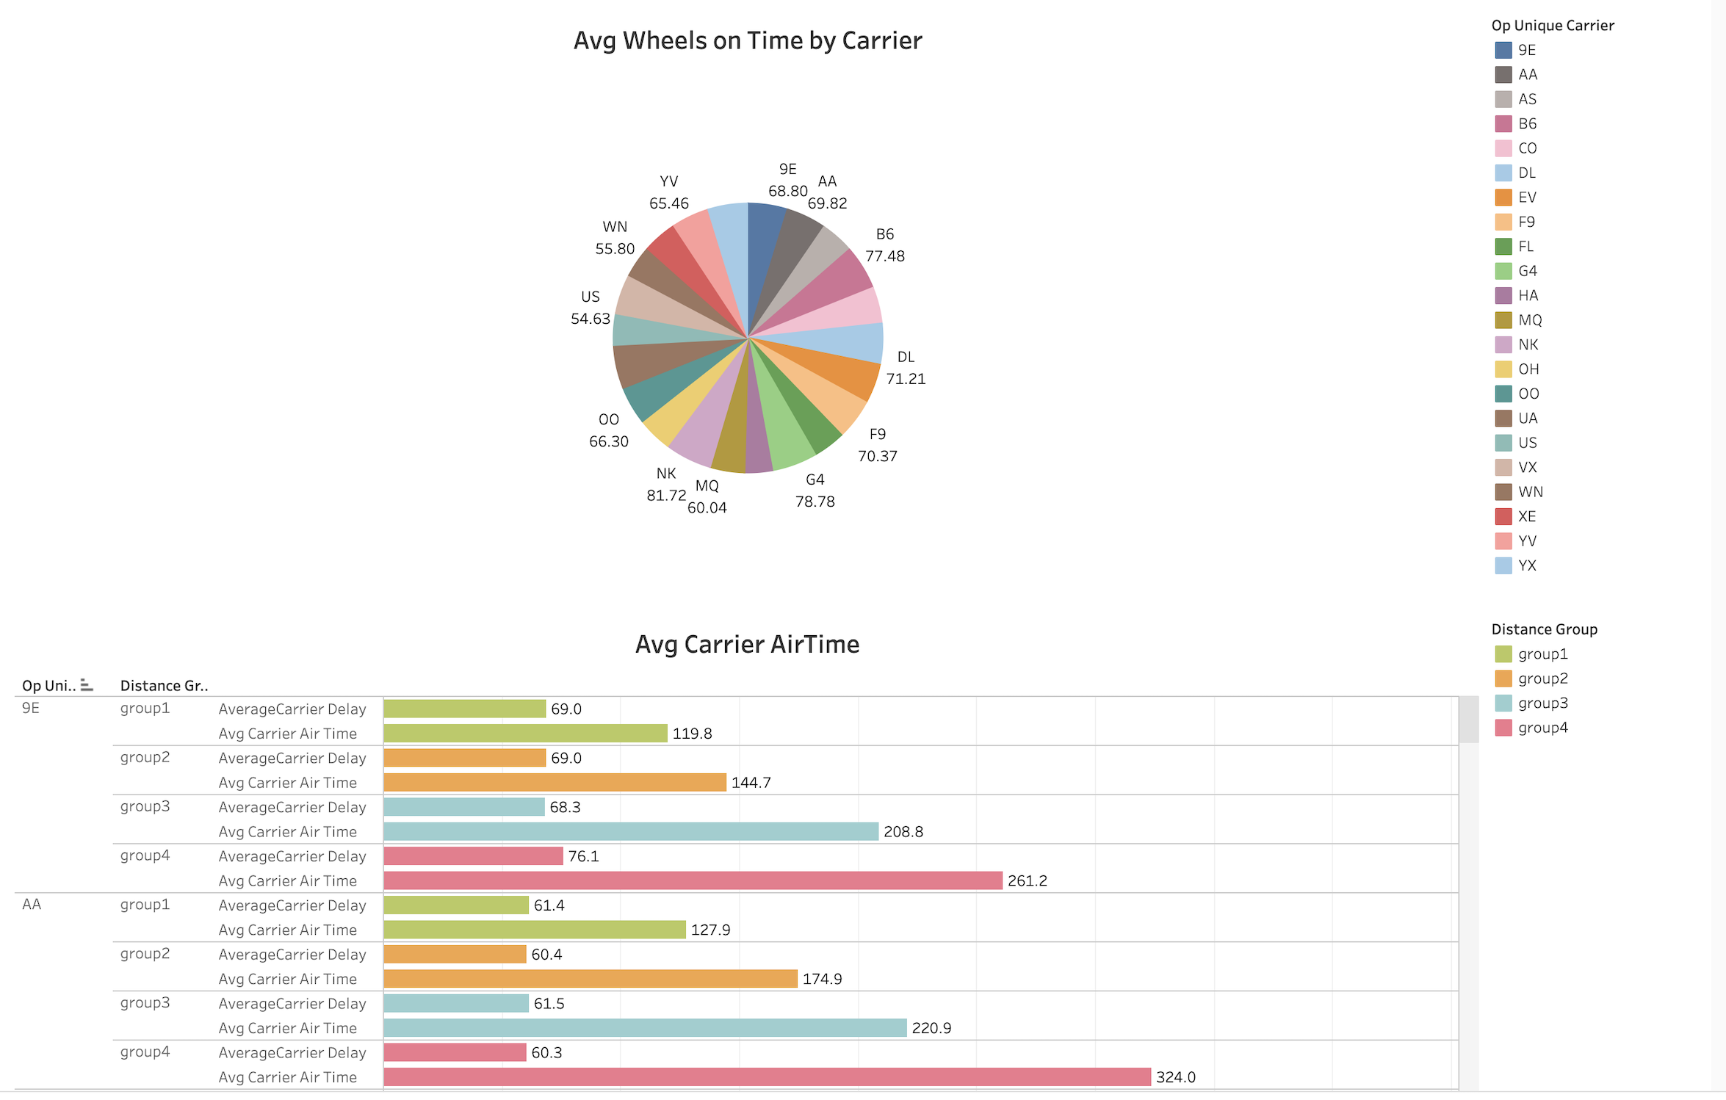
Tableau Data Visualization:
Team:2

Slide 22
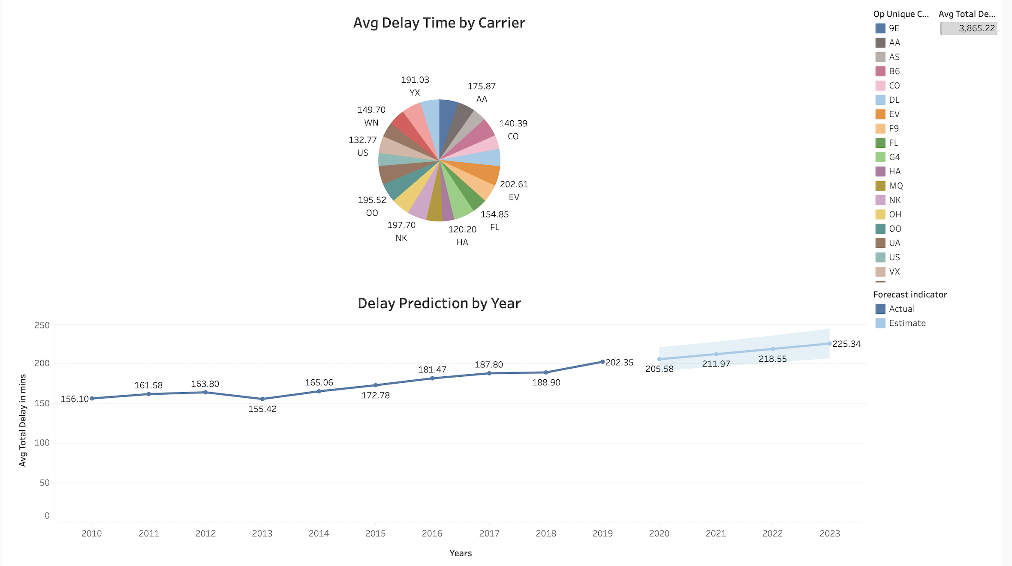
Tableau Data Visualization:
Team:2

Slide 23
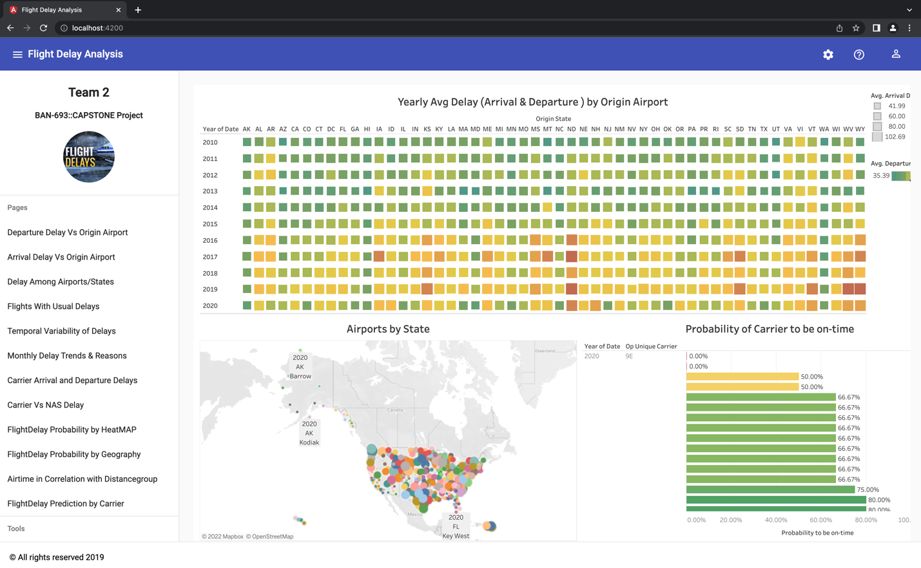
Website Hosting:
Team:2
GitHub URL: https://github.com/DeepthiMounica/FlightDelayAnalysis

Slide 24
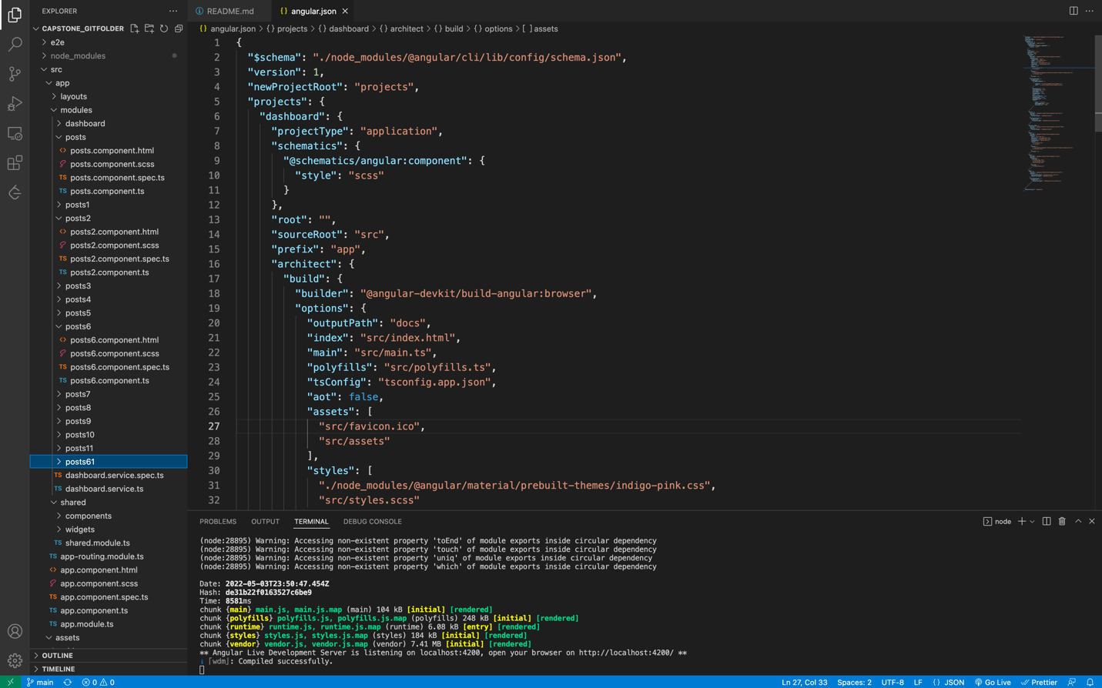
UI Project Structure:
Team:2
GitHub URL: https://github.com/DeepthiMounica/FlightDelayAnalysis

Slide 25
Technical Challenges faced:
Team:2
Building the multilevel Dashboards in Tableau occupied extended time in stringent deadlines.
Working on website design and embedding dashboards in website are time taking tasks. For coding, testing, and debugging activities.
Installing single node Hadoop cluster in personal laptop and configuring

Slide 26
Conclusion:
Team:2
Our Analysis on Flight delays as shown in the graphical interactive interface, user can quickly gain the knowledge about expected delays for desired origin and destination airports for Different carriers, there by making the wise choice in selecting carrier that have highest probability to be on time.
This analysis is available in UI website and made available in Git repository for hosting website upon project approval.

Slide 27
Open To The Floor:
Any Queries ?

